Slide 1
Prisoner’s dilemma network effect
COMPUTATIONAL PHYSICS PROJECT

Slide 2




Members:
Mahdi Rasouli
Alireza Hashemi
Fahimeh Fakhri
Yeganeh Bahari

Slide 3
cooperation
Alireza : main.py , strategy_assign.py , numbers_of_strategies.py , plot_final.py
Mahdi : network_generator.py , update_strategy.py , strategy_Matrix.py , main.py
Yeganeh :numbers_of_strategies.py , histogram.py , main.py , update.py , strategy_assign.py
Fahimeh: time_distribution.py , evolve.py , main.py , update.py , strategy_assign.py

Slide 4
Functions structure
Main : use all functions to do total game and report total reward of each strategy and plot results
Network_generator: generate requested network
Strategy_assign: distributes a list of strategies among agents
Update_strategy: update strategies to winner strategiy by distribution
Strategy_matrix: matrix of final reward for each agent
Number_of_strategies: list of distribution of all strategies
Time_distribution:normal distribution
Final_plot , evolve: shows time evolution of strategies
Histogram :shows final distribution of strategies

Slide 5
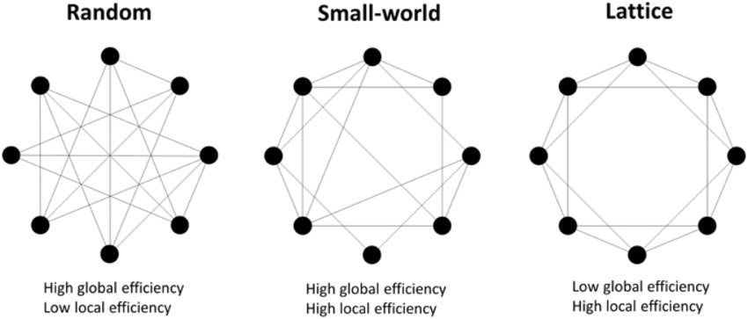
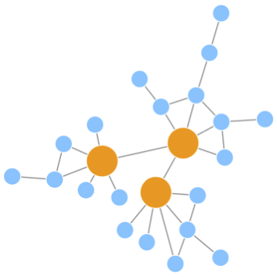
Network structure
Scale free
Barabasi-Albert
Erdos-renyi
Watts-strogatz

Slide 6
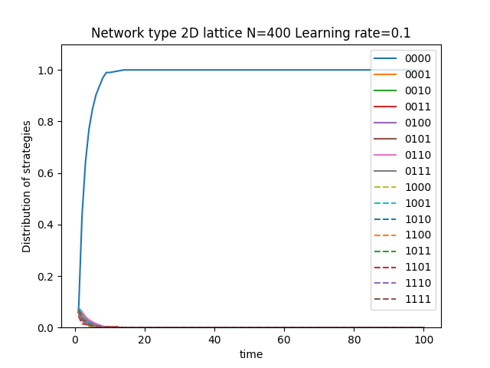
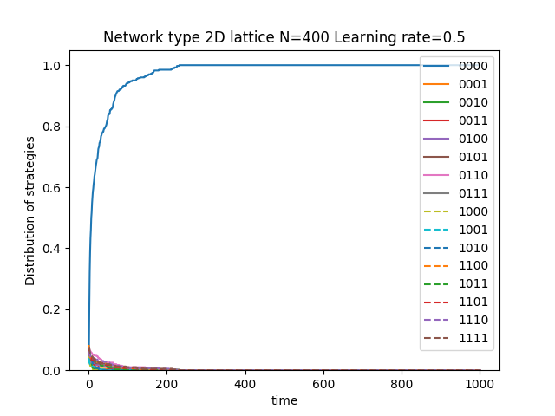
Results

Slide 7
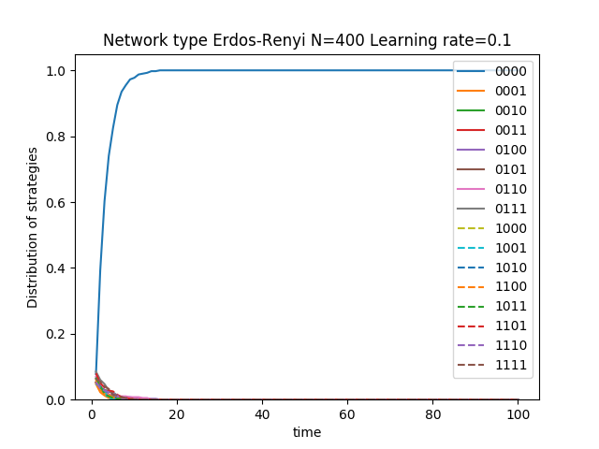
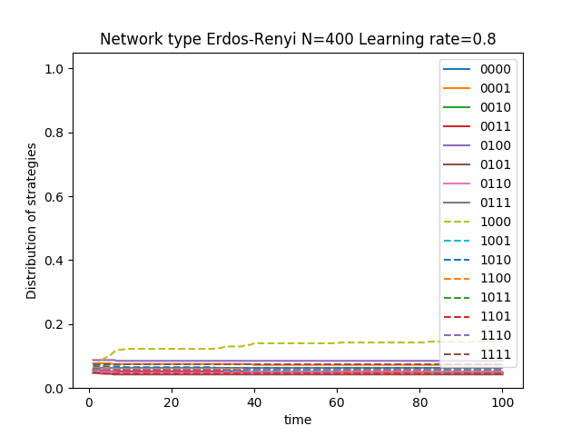
Results

Slide 8
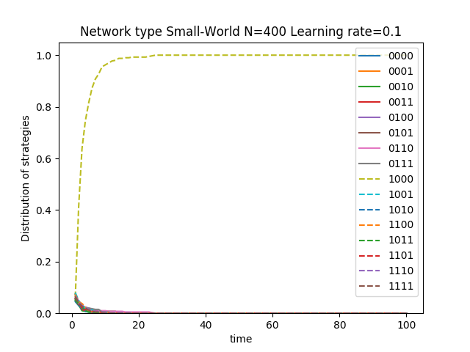
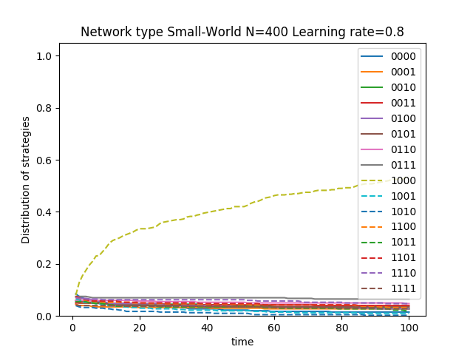
Results

Slide 9
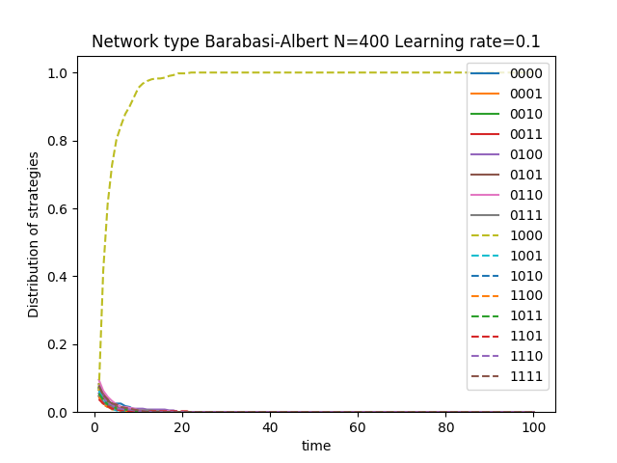
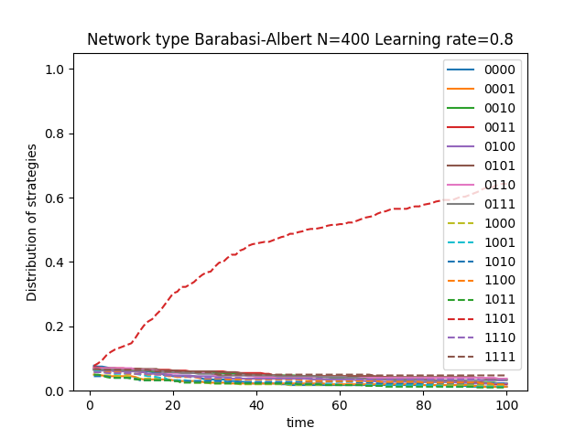
Results

Slide 10
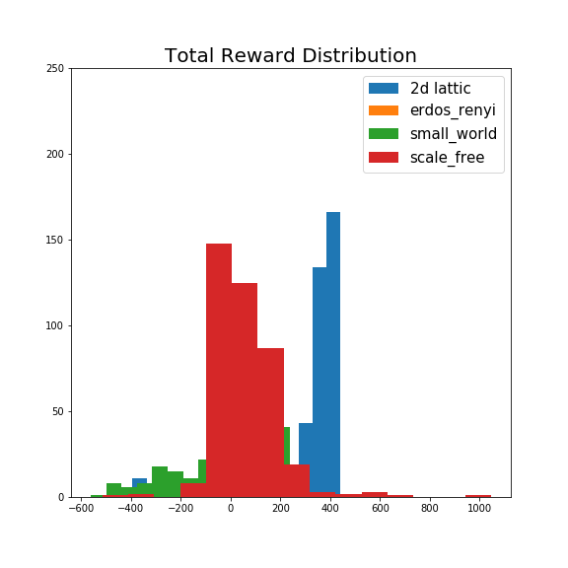
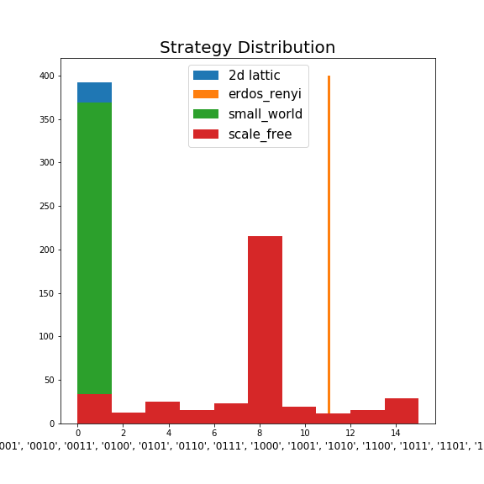
Final histogram

